Slide 1
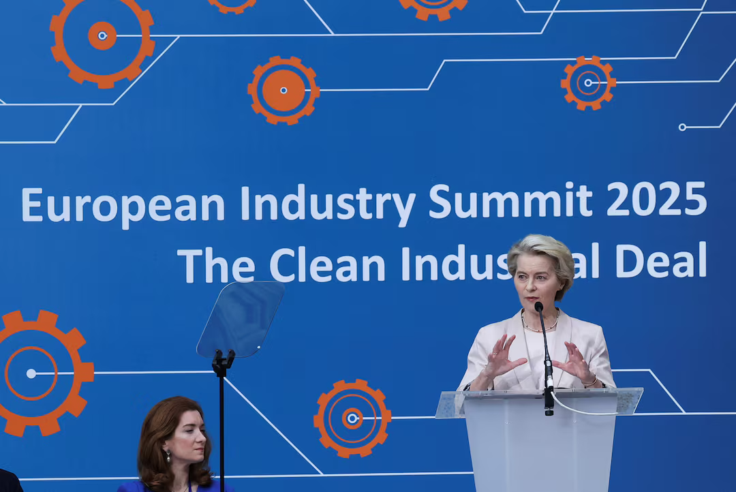
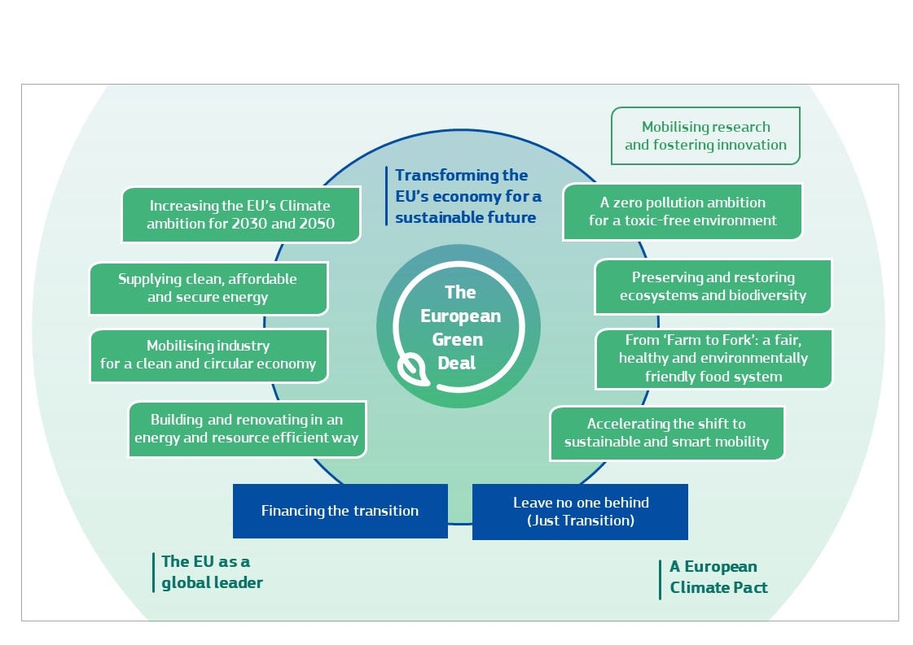
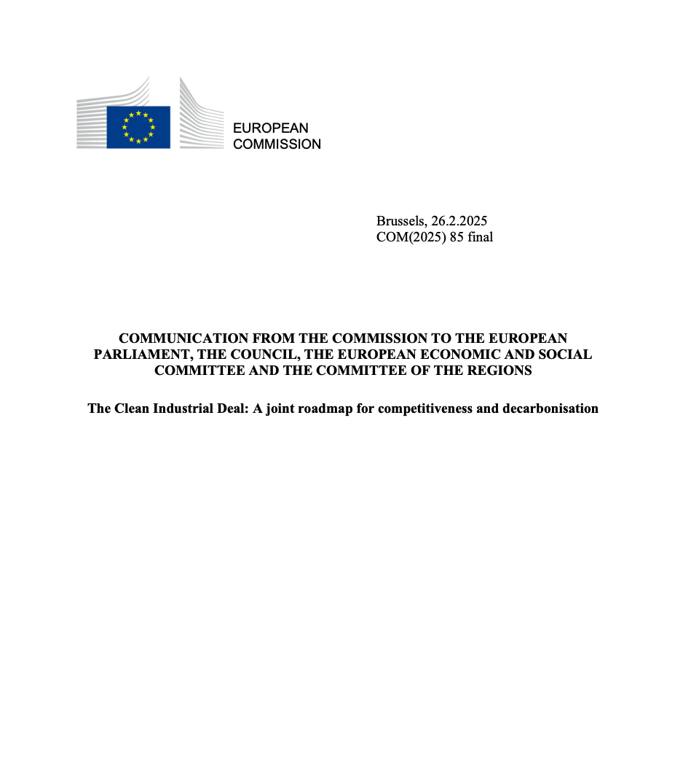

Slide 2




Action Plan on Affordable Energy
Clean Tech
Energy cost
Energy Union
Made in Europe:
Lead markets
Financing the Clean Transition
Critical Raw Materials
processing
ACCESS TO RAW MATERIALS

Slide 3
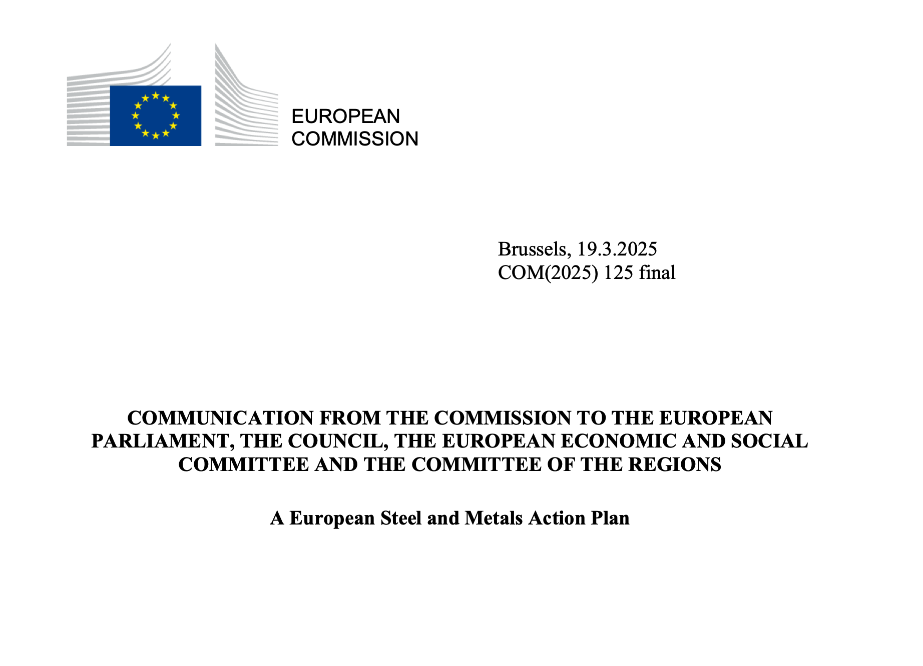
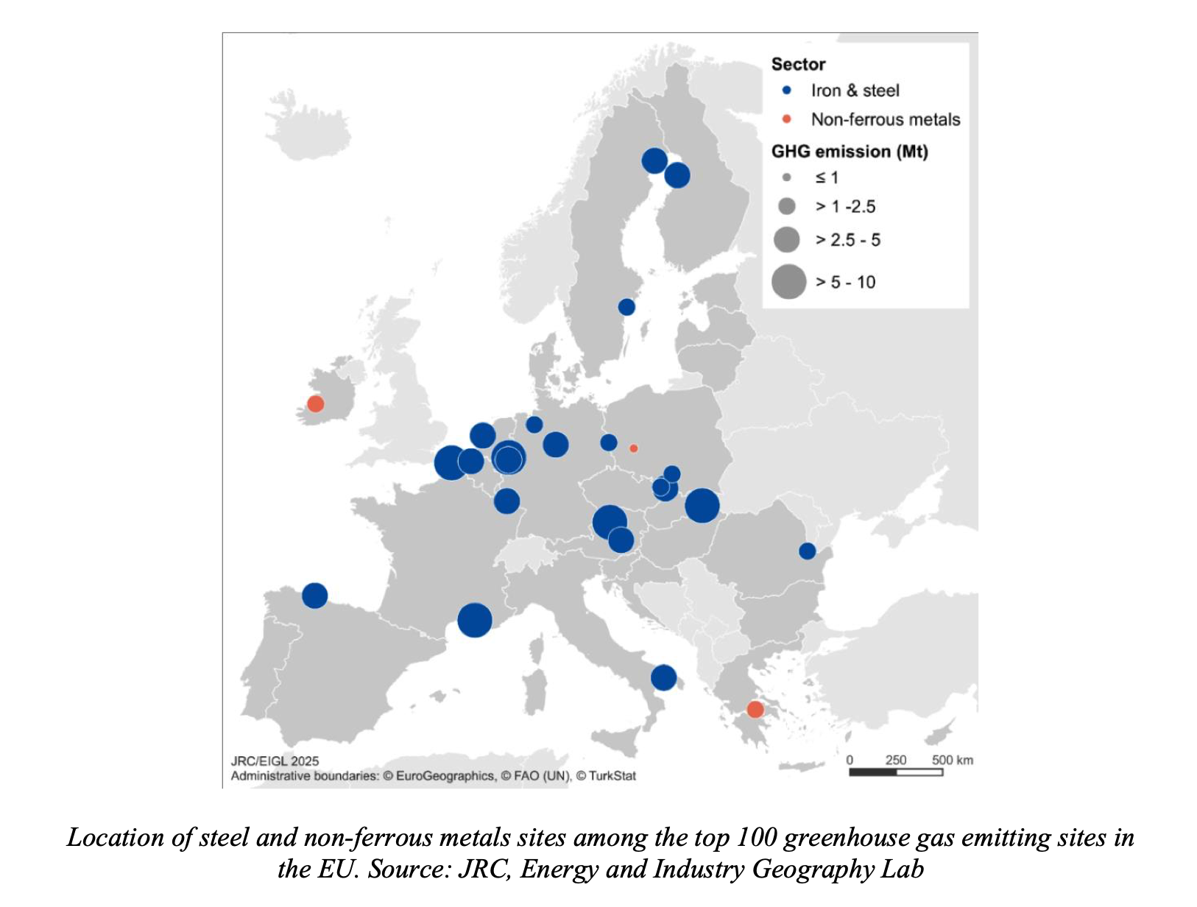

Slide 4


SINGLE MARKET / EØS
STATE AID
MADE IN EU
review of the General Block Exemption Regulation
IPCEI
CBAM
NZIA
CRMA
PROCUREMENT
christophe@eydecluster.com

